Slide 1

Big Data Advanced Analytics
Forecasting Sales in the E-commerce Sector
Muhamad Ilyas Haikal

Slide 2
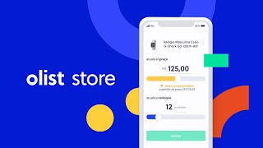
Data Collection
Public dataset published by Olist on Kaggle.
Data Source : brazilian-ecommerce
Project Files : drive.google
Brazilian E-Commerce platform Founded in 2015. Data from 2016 - 2018.
Olist has primarily shared Order
transaction data, product data
and seller data.

Slide 3
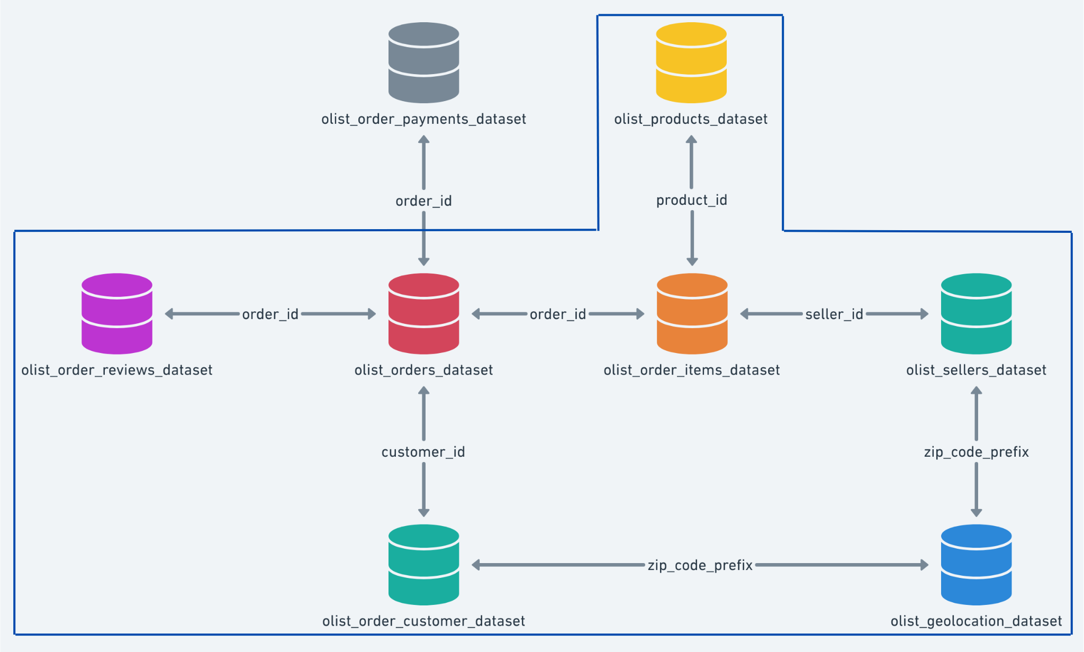
Data Schema
DATA PROCESSING
Joined these csv files to make a master table with 110013 observations with 29 features.
Removed duplicates and imputed null values.
After cleaning final data set has all the orders with delivered status.
Added extra feature ‘holiday’ after scarping it from Brazilian national holiday website.

Slide 4
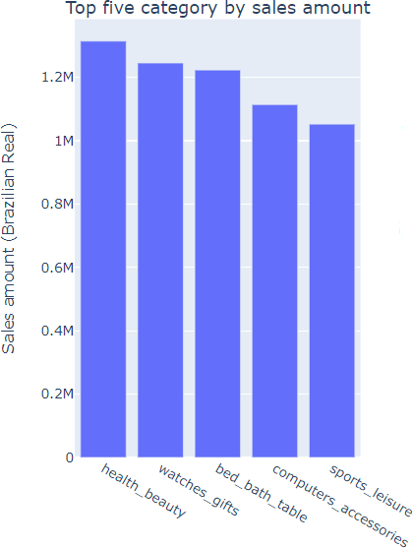
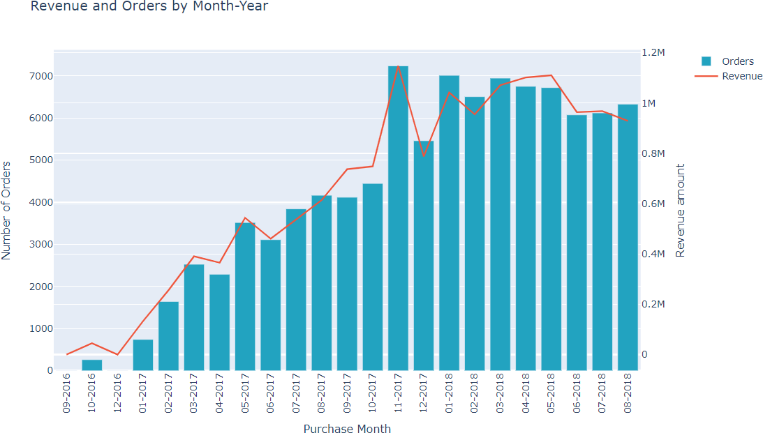
Data Insights
INSIGHT
A total of 96K unique orders.
Olist platform has 96.79 % as new customers and 3.21% have made repeat purchase.
A total of 32K different products belonging to 74 categories are sold.
The overall revenue earned as of Aug 2018 is 14.9 million Brazilian Real (R$).
There was a highest sale of 184K R$ that was recorded on Black Friday 2017.
The top five categories are shown here in the bar chart.
The monthly orders and revenue earned show a growth.
Enhance current b

Slide 5
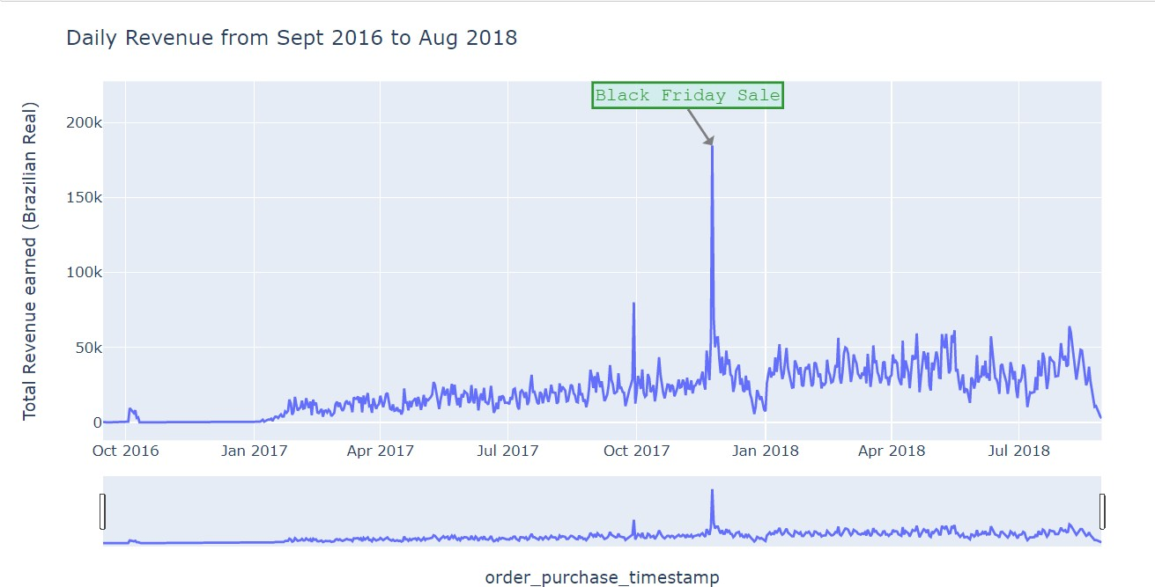
Time Series Data Pre-processing
Observations
Aggregated the Sales amount by date and it reduced the datapoints to two years of data with 606 observations.
Target variable: Sales
Note: Freight charges were not included as Olist outsourced logistics to third party till 2020.

Slide 6
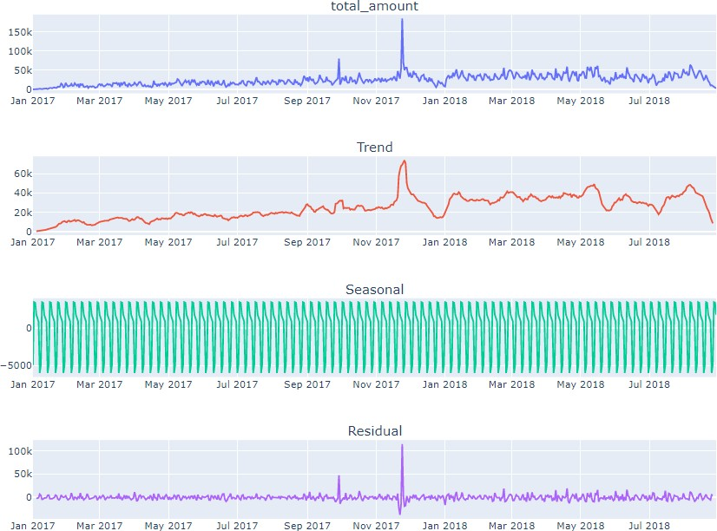
Time Series Analysis
Observations
Observed weekly seasonality.
Positive Trend.
There was almost 99% increase in revenue from 2016 to 2017 and 17.4% increase in 2018.
Huge impact of holidays like Black Friday sale.

Slide 7
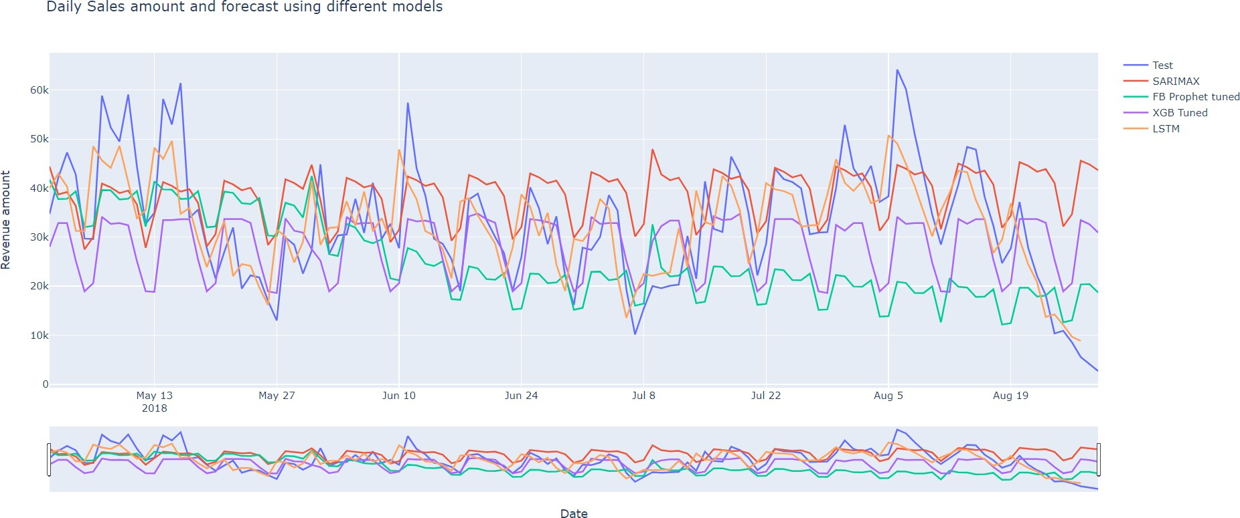
Models Applied
Applied four different approaches
SARIMAX model including holiday impact.
Tuned Facebook Prophet including holiday impact.
Tuned XG boost including holiday impact.
LSTM one step ahead.
Using grid search did hyperparameter tuning for each model.

Slide 8
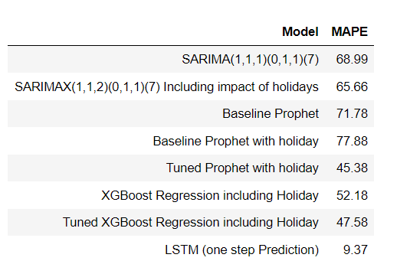
Model Evaluation
Evaluation and Selection of Model
LSTM one step ahead univariate neural network has least MAPE and was trained on limited data. It being a neural network should be fed more data and could be tested further to see actual performance.
XG Boost next best performance, but it is not able to pick up trend and variations between weeks.
Choosing tuned FB prophet as final models.

Slide 9
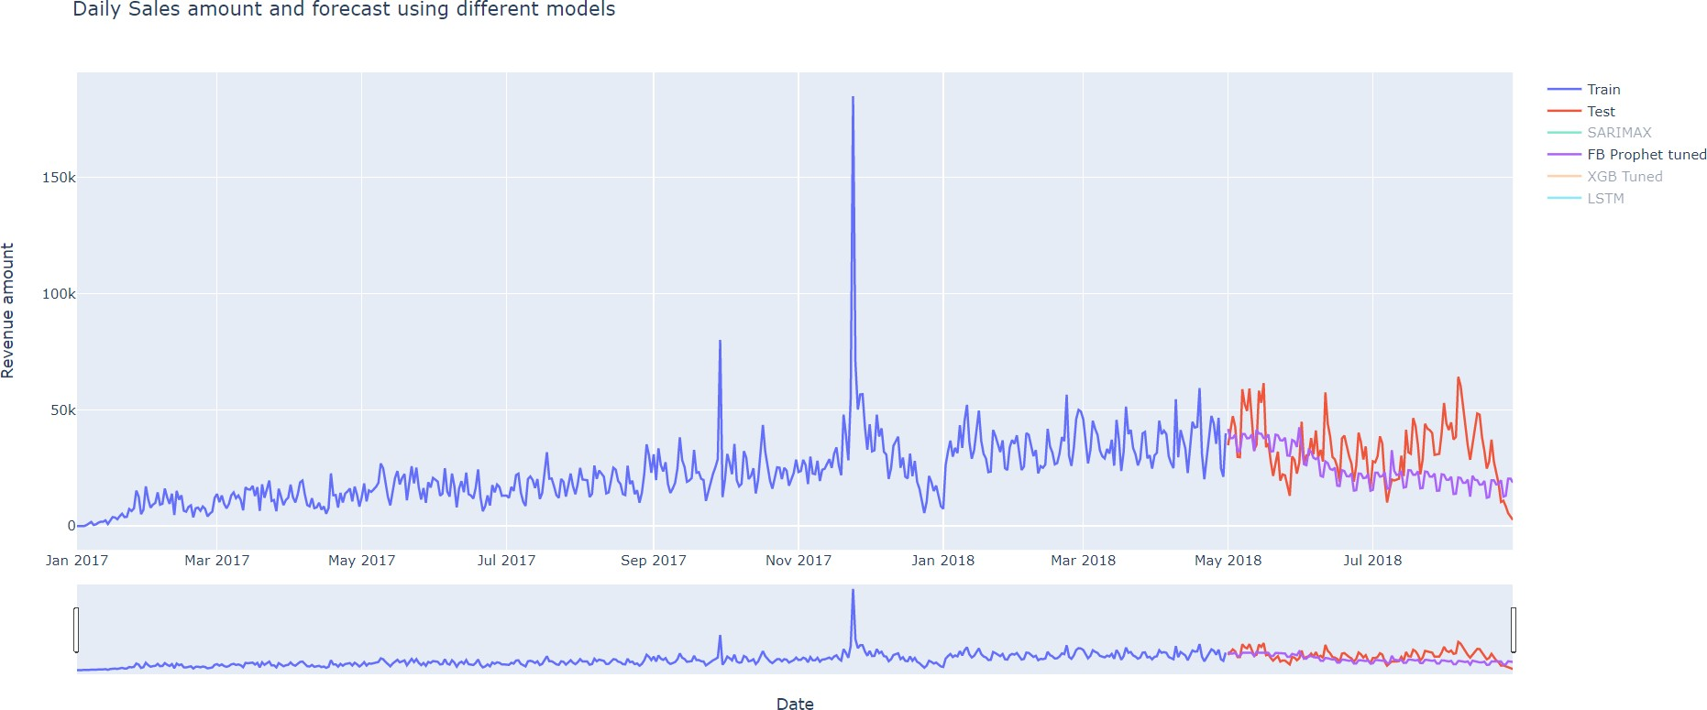
Facebook Prophet Results
Going Ahead with FB Prophet.
Able to pick seasonality, trend and variation within week.
Gives a MAPE of 51.45% considerable performance.
Parameters of tuned Facebook prophet model
Growth | Changepoint_prior_scale | Holidays_prior_scale | Seasonality_mode | Seasonality | Seasonality_prior_scale
Linear | 0.4 | 0.8 | Multiplicative | ľíue foí yeaíly, weekly and daily seasonality | 10

Slide 10
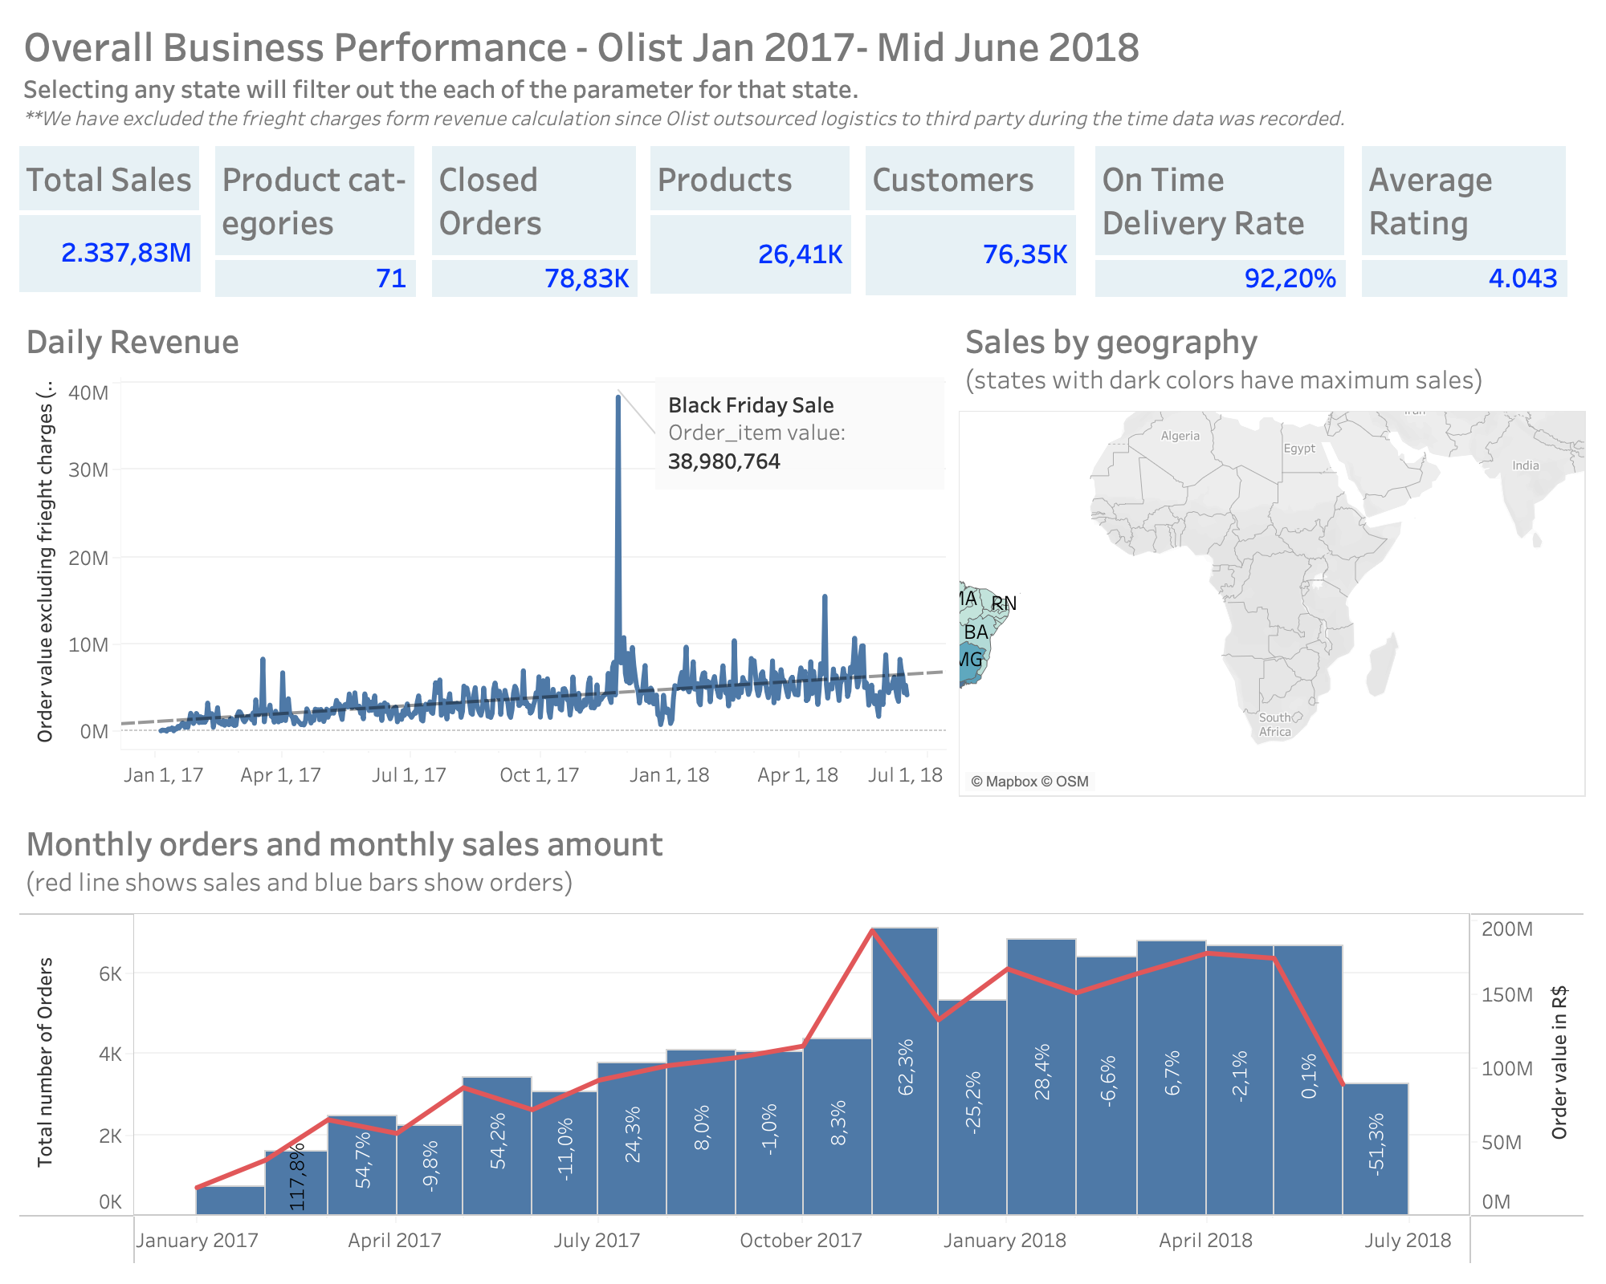
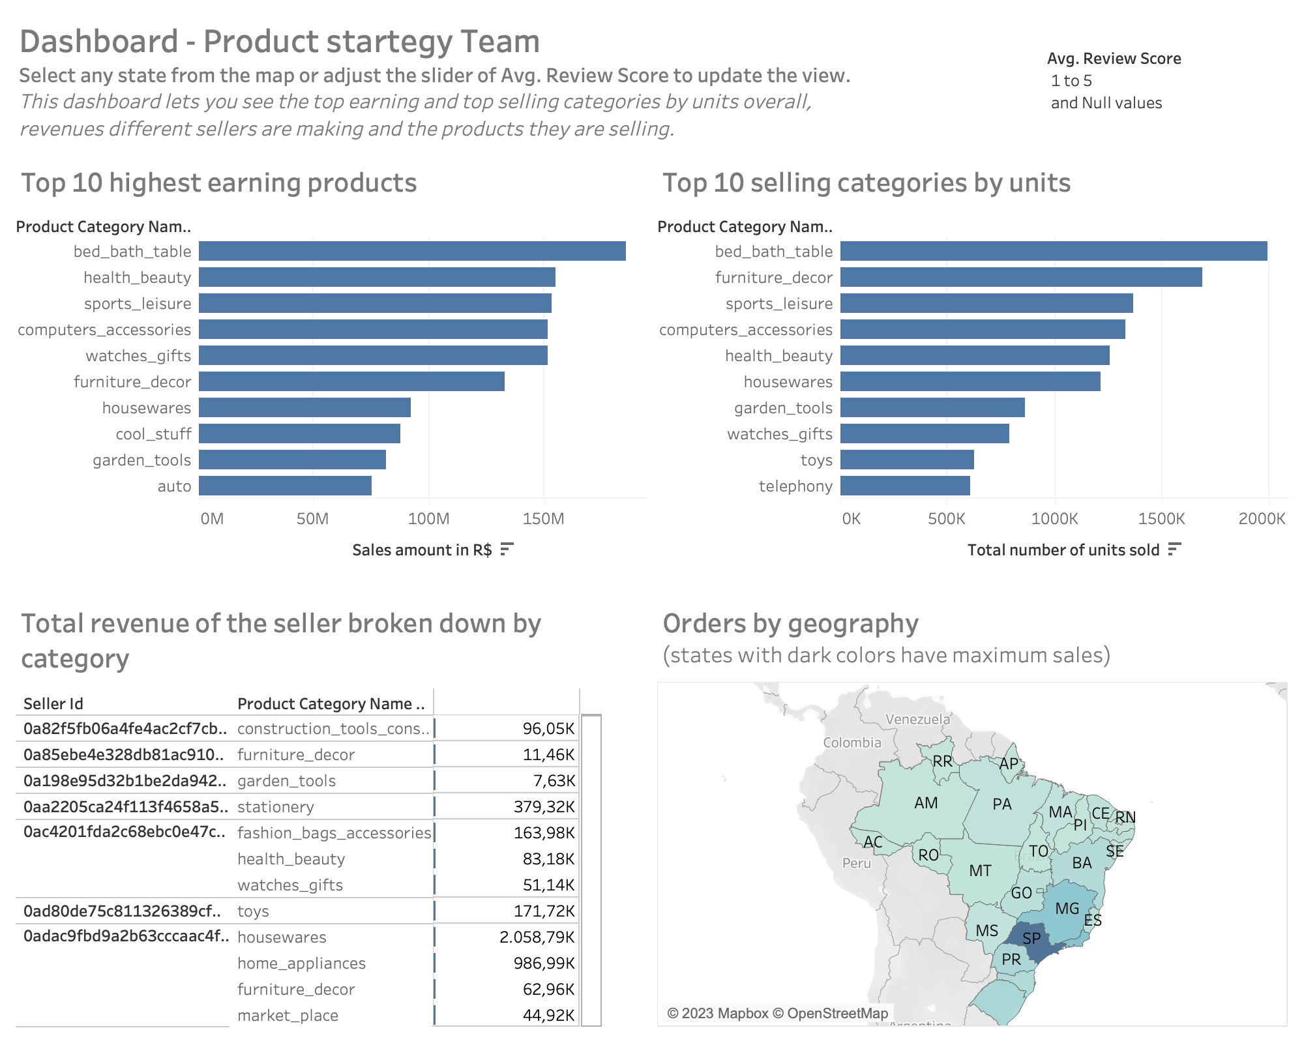
Tableau Dashboard

Slide 11
Business Strategy
Business Insight & Strategy Simplified
1. Boosting Customer Loyalty:
Opportunity: Low repeat purchases at 3.21%.
Strategies:
Launch loyalty programs.
Engage with personalized marketing.
Upgrade customer service.
2. Efficient Inventory Management:
Challenge: Managing diverse 32K products.
Focus: Top five sales categories.
Strategies:
Prioritize high-performing categories.
Predict growing demand using analytics.
Partner with leading brands for exclusive products.
3. Maximizing Revenue Through Promotions:
Insight: Revenue spikes on events like Black Friday.
Strategies:
Organize sales campaigns on holidays/events.
Use past data for future event planning.
Promote upcoming events via social media and email.
4. Enhanced Sales Forecasting:
Tool: FB Prophet model identifies key sales trends.
Strategies:
Utilize model outputs for budgeting and planning.
Update forecasting models with fresh data and insights.
Collaborate across departments for unified planning.
5. Ongoing Forecasting Model Improvement:
Potential: LSTM model might outperform with more data.
Strategies:
Gather more detailed, high-quality data.
Continuously refine forecasting models.
Experiment with advanced models as data grows.
6. Focusing on Logistics Efficiency:
Note: Exclusion of freight charges in sales data
Strategies:
Build stronger logistics partnerships.
Prepare for high-demand periods.
Explore the impact of logistics on customer experiences.

Slide 12

THANK YOU

